Slide 1
F# for Financial Computing
Tomas Petricek
http://tomasp.net

Slide 2
Agenda
Why F# matters
Accessing data with type providers
Functional & explorative programming
Scientific computing with F#

Slide 3
Analytical Components
Finance
Risk Analysis
Valuation Engines
Trading
Trading Platforms
Algorithmic Trading
Web
Ranking
Face Recognition
Retail
Recommender Systems
Fraud detection

Slide 4
Developing Analytical Components
Time to Market
Efficiency
Correctness
Complexity

Slide 5
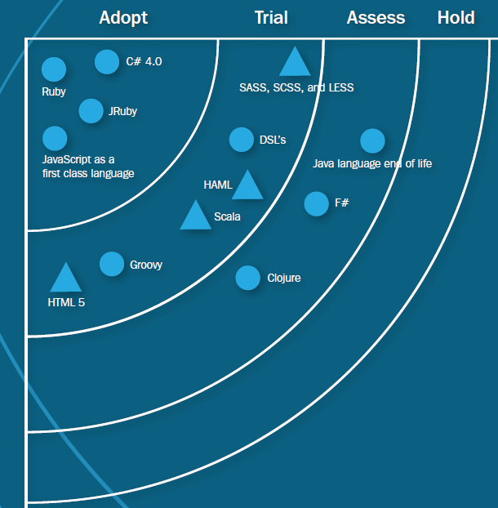
ThoughtWorks Technology Radar
Developers trying to achieve explicit business logic within an application may opt to express their domain in F# with the majority of plumbing code in C#.
ThoughtWorks Technology Radar (March 2012)

Slide 6
Agenda
Why F# matters
Accessing data with type providers
Functional & explorative programming
Scientific computing with F#

Slide 7
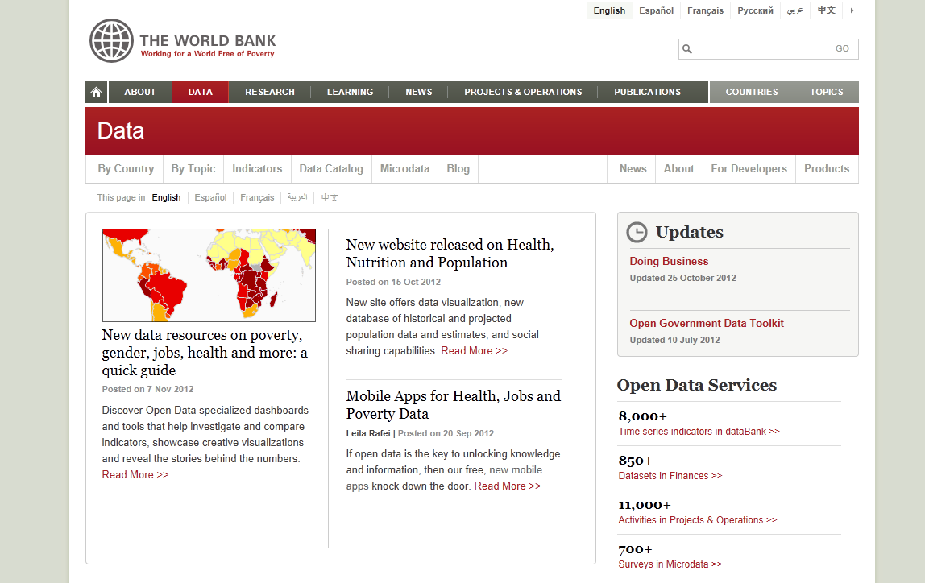
Accessing data today

Slide 8
Languages and Data
Mismatch between two worlds!
Structure in the language
Classes with properties
Functional data types
Structure in the data source
Database, XML, OData, Web services
CSV file, REST service or JSON file

Slide 9
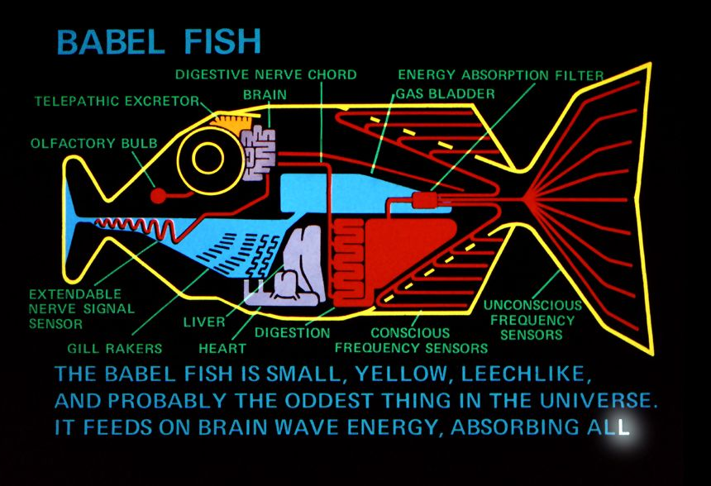
F# Type Providers

Slide 10
Processing CSV files in F#
Stock prices from Yahoo Finance
What we want to write
Column names
Open, High, Low, Close, Volume, Adj
31.25, 31.73, 30.55, 30.77, 14122000, 30.77
31.92, 31.99, 30.76, 31.10, 19526900, 31.10
31.96, 32.19, 30.90, 31.36, 17713300, 31.36
(...)
Data set
Column names
let fbstocks = (...)
for row in fbstocks.Data do
printfn "%f" (row.Close - row.Open)

Slide 11
Demo #1
Analyzing WorldBank data

Slide 12
What type providers do?
Compiler
Type-Check Imported Types
Compile using Type Provider
Type provider
IDE
IntelliSense for Generated Types

Slide 13
Agenda
Why F# matters
Accessing data with type providers
Functional & explorative programming
Scientific computing with F#

Slide 14

Functional programming
$$x=x+1$$

Slide 15

Functional programming
Functional programming emphasizes the evaluation of expressions, rather than execution of commands. The expressions in these languages are formed by using functions to combine basic values.
This is how mathematics works!
Roots of a quadratic equation
$$\frac{−b±\sqrt{b^{2}−4ac}}{2a}$$

Slide 16
Functional programming
Program as an equation
Equations can get long and ugly
How to break them into pieces?
More ideas from mathematics

Slide 17
The let keyword
Immutable values
Function declarations
Type float is inferred (efficiency & correctness)
> let a = 3.0
val a : float = 3.0
> a = 2.0
val it : bool = false
Normal value cannot be mutated
Add function parameters
> let twice a = a * 2.0
val twice : float -> float
Still no need to write the type!

Slide 18
Expressions at a larger scale
Calculating with trades instead of numbers
Declarative specification, multiple uses
What can happen on a given date?
Valuation and risk assessment
let itcontract =
sellOn
(DateTime(2012, 4, 30)) ("MSFT", 23.0) $
purchaseRepeatedly
(DateTime(2012, 4, 23))
(TimeSpan.FromDays(7.0))
10 ("AAPL", 220.0)

Slide 19
Demo #2
Visualizing stock options

Slide 20
Agenda
Why F# matters
Accessing data with type providers
Functional & explorative programming
Scientific computing with F#

Slide 21
Why write calculations in F#?
Efficient
Interoperability & good libraries
Compiled to native code by JIT
Generic code
Better than C#, simplified by type inference
Correctness
Types help avoid mistakes
Advanced checking with units of measure

Slide 22
F# Technologies
Standard F# tools
F# language and core libraries
Math libraries
Math.NET Numerics (open source)
StatFactory FCore, QuantAlea GPGPU
Machine-learning packages
Microsoft Solver Foundation, Infer .NET

Slide 23
Working with stock prices
Obtaining stock prices from Yahoo
Using CSV type provider
Using units of measure
Avoiding common mistakes
Working with collections in F#
Functions and sequence expressions

Slide 24

Demo #3
Statistics reminder (standard deviation)
Analyzing Facebook stock price
$$\sqrt{\frac{\sum{{(v_{i}−avg)}^{2}}}{count}}$$

Slide 25
How functional programmers think
Data-centric design
What data does the program use?
How to represent the data?
How to transform between representations?
Implementing design
Domain on a single page
Transformations are functions

Slide 26
Data Structures
Define data structures first
Model data by composing primitives
Three basic functional types
Tuples and Records
Discriminated Unions
Collections
Combine values of different types
Represent one of alternative options
Zero or more values of the same type

Slide 27
Demo #4
Parallelizing Black-Scholes pricing

Slide 28
Parallel computing etc.
Parallel programming
Run faster on multi-core
Asynchronous programming
Avoid blocking I/O
Concurrent programming
Computations that communicate

Slide 29
Summary

Slide 30
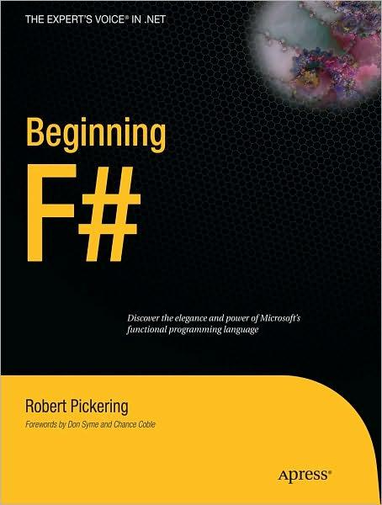
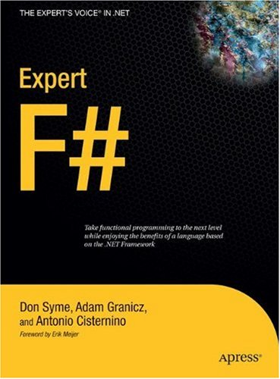
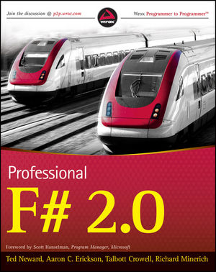
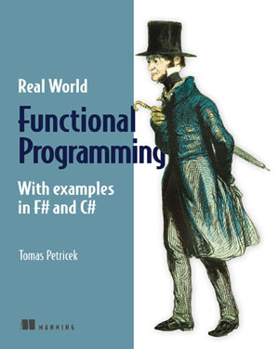


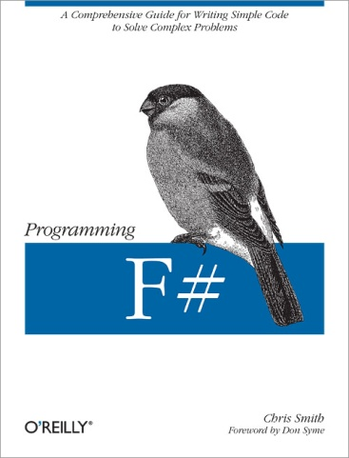
F# Books

Slide 31
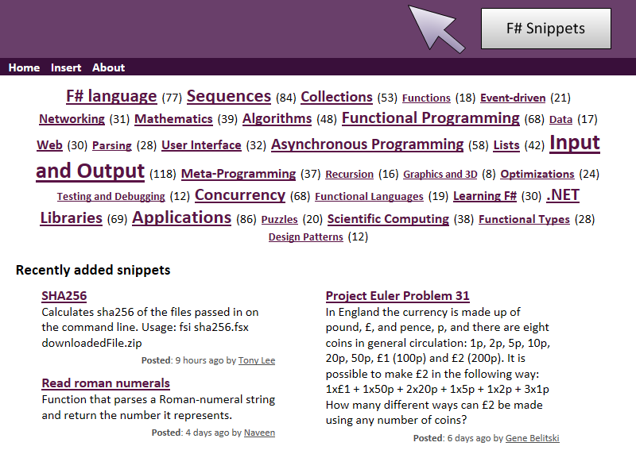
F# on the internet
F# Foundation
http://fsharp.org
F# Snippets
http://fssnip.net
MSDN Articles
http://functional-programming.net/msdn
StackOverflow
http://stackoverflow.com/

Slide 32
Thanks!
Questions?
Get in touch!
Email: tomas@tomasp.net
Web site: http://tomasp.net
Twitter: @tomaspetricek

